Slide 1
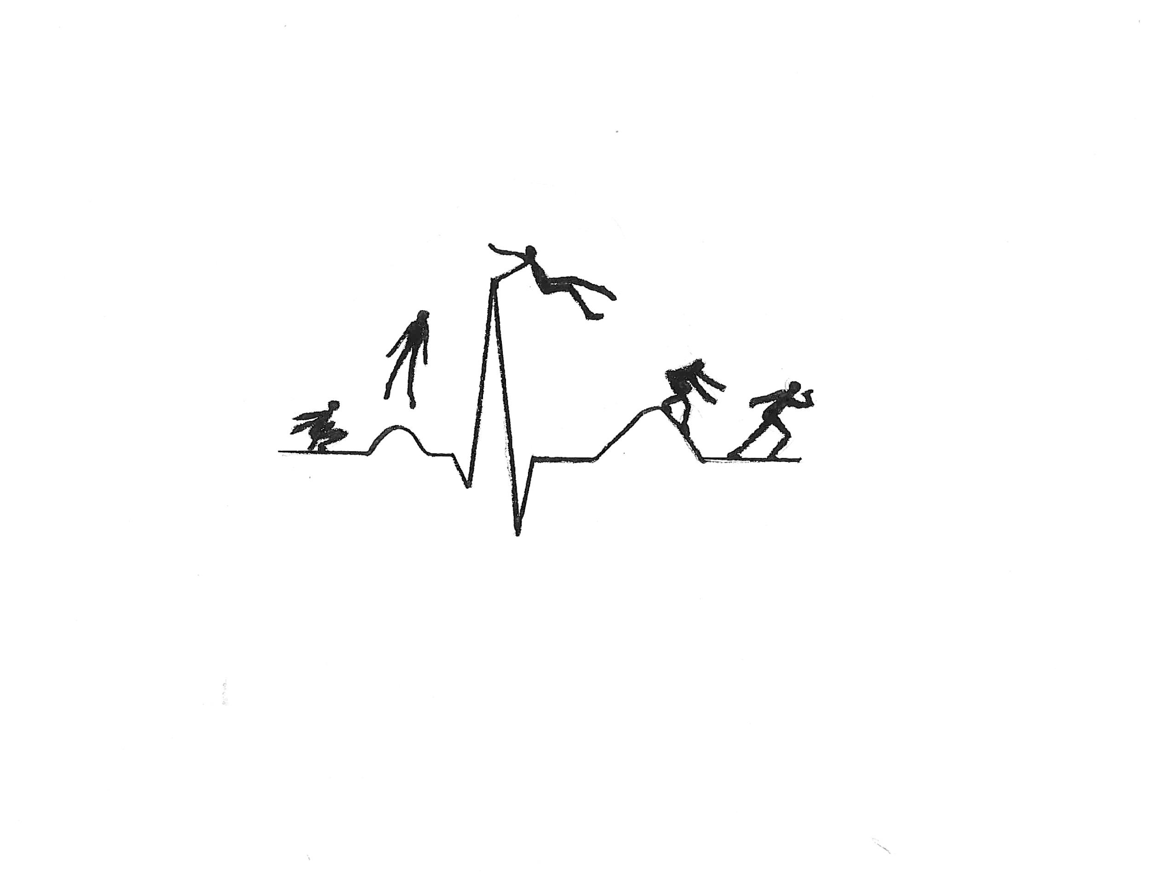
Jump Into Health Care (JIHC): Design of a Problem-Based Summer Enrichment Pipeline Program
Katherine Beissner
Eunice Choe
Deashia McAlpine
Danielle Fuller-Sincock
Jisung Shin

Slide 2
Disclosures
None

Slide 3
Acknowledgement
Program development partially funded by the Green Family Foundation

Slide 4
Agenda
Program Overview
Case Construction
Public Health components

Slide 5
JIHC - a Workforce Diversity Initiative
Health disparities
Diverse patient population
Barriers to care, including therapeutic alliance
Little awareness of career opportunities beyond MD and RN
Economic opportunity

Slide 6
Setting
Syracuse NY, population ~142,300
Racially diverse (50% NH White, 30% Black/AA)
Major Industries: Healthcare, Higher education
Community challenges
High poverty (~32%), low HS graduation rate (~62%)
Community strengths
Abundant community partners

Slide 7
Upstate Medical University
Academic Medical Center
4 colleges: health professions, medicine, nursing, graduate studies
Excellent facilities – simulation center, anatomage table, teaching laboratories, library, hospitals

Slide 8
Upstate Pipeline Programs
Admissions pathways
Career awareness programs
HS Enrichment programming
Health Career Coaching
Afternoon enrichment (Medical Education for Diverse Students)
MASH camps, etc.

Slide 9
JIHC - overview
5 weeks, full time
Week 1 – orientation (HIPAA, professional behavior, etc), library skills, parade of professions, form groups, first case
Week 2-5 – one case/week, increasing complexity. Groups presentations on Fridays
Week 5: pairs develop/present their own case

Slide 10
Why PBL for JIHC?
Traditional programming available elsewhere
Academic Medical Center opportunities
PBL benefits
Active, team-based learning
Develops information-seeking skills
Problem solving

Slide 11
JIHC – daily structure
Time | Activity
9-9:30 | Gather, warm up
9:30 – 10:30 | Case work (a)
10:30 – 10:45 | Break
10:45 – 11:30 | Case work (b)
11:30 – 12:00 | Specialized training – library, study skills,…
12 – 12:30 | Movement!
12:30 – 1:00 | Lunch
1:00 – 2:45 | Afternoon enrichment: Guests, field trips; job shadows
2:45 – 3 | Closing comments. What to think about tonight.

Slide 12
2020 Version
Program cancellation
Case Development
Pilot testing of cases

Slide 13
Case Construction
Brainstorm and select case topics
Research topics and write cases
Present cases and gather feedback
Edit cases
Write tutor guidebook
Notes:
I will be speaking about how we developed the cases and gathered feedback. When we began writing the cases, we selected topics that were relevant to high school students, relevant to the Syracuse area, included a wide range of health care professions, and included a public health component. We then researched the case topics thoroughly using medical case studies, news articles, and legal cases to develop realistic backstories for our patients. We then presented the cases to the students, gathered feedback in small groups, used their feedback to edit the cases, and then compiled our notes in a tutor guidebook so that the program could be run by medical or non-medical tutors in the future.
Writing the cases
Brainstorm case topics
Select disease
Disease selection criteria
Relevance to high school students
Drunk driving
Relevance to Syracuse area
Lyme disease
Spectrum of interdisciplinary care
Public health involvement
Preeclampsia
Type 2 diabetes
Understand how to write a problem based learning module
Research topic
News articles, legal cases,
Access Medicine case studies
Pubmed case studies
Establish content goals
Develop case backstory and entry into the healthcare system
Seek lab tests and values from cases to further develop medical case presentation
Develop guiding questions for tutors
Brainstorm image ideas for illustrator
Presenting the cases
Taught students how to interview patients and take a medical history
Presented the case online and in person
Presented part 1
Paired students with tutors for discussions
Reconvened to discuss as a large group
Continued this pattern for the whole case
Gathered feedback
Editing the cases
Presented the edited case to new students who hadn't seen it before
Gathered feedback
Writing tutor guidebook

Slide 14
“My Back Hurts”
Part 1
Storyline: Alcohol-induced motor vehicle accident
Chief Complaint: “My lower back hurts, my legs are numb, and I’m scared.”
Review of systems
Physical exam
Vital signs, musculoskeletal exam, and neurological exam
Questions
What anatomical structures are you most concerned with? Why?
What are your top three differential diagnoses?
What imaging do you need to confirm her diagnosis? What are you looking for with each type of imaging?
Notes:
students practice patient interview
As an example, here’s an excerpt from one of the cases that I wrote. The backstory is a high school senior who was involved in an alcohol-induced motor vehicle accident. She sustained a lower vertebral fracture with spinal cord injury and was brought to a Level 1 trauma center. The chief complaint was, “My lower back hurts, my legs are numb, and I’m scared.”
When we presented this case to the students, we first taught them how to conduct a patient interview. They pretended that they were the ED physician gathering the patient history and coming up with a diagnosis. The students learned what types of questions to ask when gathering a medical history, and they practiced asking the tutors questions to get the answers for the review of systems and physical exam.
At the end of Part 1 of our cases, the questions typically asked the students to think about related anatomy, their top 3 diagnoses, and what type of imaging or lab values they needed to confirm their diagnoses.

Slide 15
Part 2a
Part 2b
Imaging studies
Describe the anatomy of the vertebral column and spinal cord.
What are the three most common vertebral fractures?
Based on new information, what’s your most likely diagnosis?
Pathophysiology
What are her neurological deficits?
How did her injuries lead to her physical symptoms?
Calculate her Thoracolumbar Injury Classification and Severity Score (TLICS).
Why is immediate surgery necessary in her case?
Anna Henry 2020
Notes:
Emphasize: students seeking out information
In part 2, we presented the imaging or lab values that mirrored similar medical case studies. The students would seek out information online to interpret the data and understand the pathophysiology of the disease. In this case, students learned about the neuroanatomy of the spinal cord and how an injury at a certain vertebral level can manifest as particular physical symptoms.
Based on new information, what's your most likely diagnosis?
How does the diagnosis explain the physical symptoms?

Slide 16
Part 3
Closure
Storyline: Outpatient spinal cord injury rehabilitation center
Questions
What are the functions of each of the spinal cord injury rehabilitation team members?
Historically in the U.S., more crash deaths have occurred in rural areas even though fewer people live in those regions. Why are people more likely to die if they have a motor vehicle accident in a rural area than in an urban area?
What are common myths about drinking and driving? Which one surprises you the most?
Notes:
In Part 3, we wrapped up the case by discussing what happened next to the patient in the healthcare system. These questions focused on the roles of different healthcare professions and the public health component of the cases.
Part 3 (and sometimes part 4)
More information
What happens next to the patient?
Long term implications of illness or accident
Questions
Understanding the health care environment
Who are the team members involved in care?
Social aspects
What are limitations to accessing care?
What are non-hospital services that are pertinent and available to these patients?
Hospice

Slide 17
Student Feedback and Challenges
Ordering of cases by difficulty or topic
Case format
Ordering of information
Types of questions asked
Difficulty of questions
Flow of questions
Surprise feedback
Sophisticated language
Notes:
When we gathered feedback from students, their overall response was that the cases were interesting, relevant, and appropriate for their level of learning. We found that it did not matter whether we started with an easier or more challenging case. Either way, the students responded by identifying points that they didn’t understand, and driving their own research by using credible search engines.
There were two pieces of surprise feedback that I wanted to share. First, we wrote the cases using original medical terminology. We were concerned that it would be too challenging for the high school level. Surprisingly, the students insisted upon including the sophisticated language because the act of looking up words they didn’t know would help them prepare for college.
Second, I wrote a case where a patient had a poor prognosis. When it came to the point in the case where the patient entered Hospice care, the students were shocked because given what the students could read online, it was more likely that the patient would have a good outcome. It was surprising to me that the students responded by saying that this is why it is so important for healthcare professionals to be careful with what they say to patients and their families and not make concrete promises about life and death because even though we may do our best to support patients through medicine, we are not in complete control over a patient’s health outcome. It was very mature for them to understand that at the high school level.

Slide 18
Public Health and Medical Education
Our goal for incorporating public health
What we did
Public Health Databases
Notes:
As medical students, we are exposed to concepts of public health but not enough. The practice of going into the community and determining why certain populations are more affected by certain health conditions has changed the way we study, diagnose, and treat patients in the health professions. We are aware of the strides they have made in the past with exposure of lead paint in houses and how this affects children, vaccinations for children entering public schools, environmental regulations to reduce pollution and taxes on tobacco products and so much more. Recently, the American Public Health Association has been writing letters to the USDA about the extension of nutrition waivers to guarantee access to healthier foods for families and they have written to the VP about COVID testing guidelines for asymptomatic individuals.
Specifically, in our cases we have students going to their local county databases and checking the prevalence of drinking and driving accidents, rate of maternal mortality across races, Lyme disease, diabetes, and food deserts. While it was difficult to be intentional about incorporating these concepts while keeping the case at a level the students can understand, we recognized the importance of learning about public health. This will give them the advantage to be further immersed in the field as they pursue careers in the health professions.

Slide 19
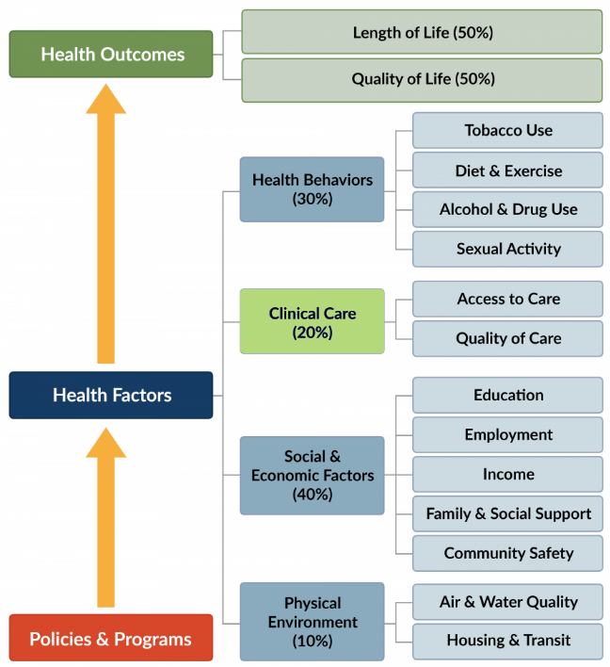
SDoH
20% Medical Care
SDoH
http://www.countyhealthrankings.org/county-health-rankings-model
Notes:
http://www.countyhealthrankings.org/county-health-rankings-model
This picture further shows why we were so adamant about incorporating public health into our cases. It shows that while clinical care is important, the social determinants of health make up a larger contribution to health outcomes. This includes health behaviors, social and economic factors, and the physical environment.
Now, I would like to highlight specific examples from a case I wrote.

Slide 20
A Complicated Delivery
Questions
What are implicit biases? How can this affect certain populations in the medical field?
What are the social determinants of health and what role do you think they play in this case?
What is the social-ecological model and what role do you think it plays in this case?
Morbidity and Mortality Conferences
Notes:
This case is about Imani who is a 30-year-old woman, that is 32 weeks pregnant, she comes to the emergency room for a headache that would not go away. She is made to wait several hours before her vitals, and history are taken. Eventually, she is seen by a doctor who does not take her condition seriously. While she is waiting to be discharged, she has a seizure and has to deliver her baby. We see how this impacts Imani down the line when she presents with postpartum depression.
This was a hard case to write, it highlights a problem in our healthcare system that I am personally passionate about. I had a difficult time balancing the medical aspects, public health concepts, and not making it too long or difficult.
The questions shown here are ones that were incorporated into this case, the questions highlight concepts that were necessary for the students to be aware of. During the passionate discussion we had, the students discussed how her past drug use, job, accidental pregnancy, and insurance status could have impacted her medical care. We also discussed how changes need to be made at the institutional level to reduce the risk of pregnancy complications and all the subsequent complications that come along with them.
My favorite part of this case is the morbidity and mortality conference that our lead doctor has to go through. The addition of the conference to this case shows the purpose of the M&M, which is upholding ethical integrity, professionalism, and transparency to improve patient outcomes. Hopefully, in this fictional world, the health professionals still in training will learn from this doctor’s mistake.

Slide 21
Planned Program Evaluation
Goals
Improve study skills
Increase awareness of HPs
Improve communication
Increase enrollment in HP program
Measurement
LASSI – HS
Surveys
Communication Battery (interpersonal, public speaking)
Long term Tracking

Slide 22
Questions?

